Slide 1


Noida Institute of Engineering and Technology, Greater Noida
Python Web Development with Django
Unit: III
Integrating Accounts & Authentication on Django
Priya Singh
(Asst. Professor)
CSE Department
Course Details (B. Tech. 5th Sem)

Slide 2

Faculty Introduction
Name | Priya Singh
Qualification | M. Tech. (Computer Engineering)
Designation | Assistant Professor
Department | Computer Science & Engineering
Total Experience | 3 years
NIET Experience | 1 years
Subject Taught | Design & Analysis of Algorithm, Data Structures, Artificial Intelligence, Soft Computing, C Programming, Web Technology, Discrete Mathematics.

Slide 3
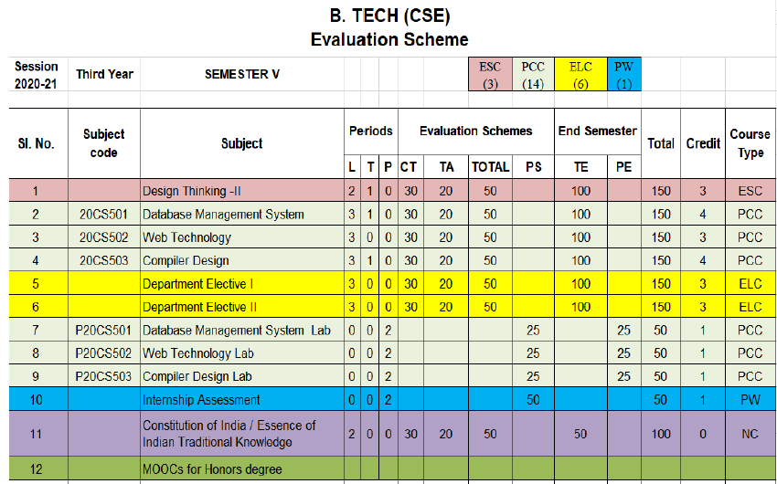
Evaluation Scheme
Python Web development with Django (Elective I)
Design Pattern (Elective II)

Slide 4
Syllabus
UNIT-I: Python libraries for web development
Collections-Container datatypes, Tkinter-GUI applications, Requests-HTTP requests, BeautifulSoup4-web scraping, Scrapy, Zappa, Dash, CherryPy, TurboGears, Flask, Web2Py,
Bottle, Falcon, CubicWeb, Quixote, Pyramid.

Slide 5
Syllabus
UNIT-II: Introduction to Django Framework
Understanding Django environment, Features of Django and Django architecture, MVC &MTV, Urls and Views, Mapping the views to URLs, Django Template, Template inheritance Django Models, Creating model for site, Converting the model into a table, Fields in Models, Integrating Bootstrap into Django, Creating tables, Creating grids, Creating carousels.

Slide 6
Syllabus
UNIT-III: Integrating Accounts & Authentication on Django
Introduction to Django Authentication System, Security Problem & Solution with Django Creating Registration Form using Django, Adding Email Field In Forms, Configuring email settings, Sending emails with Django, Adding Grid Layout On Registration Page, Adding Page Restrictions, Login Functionality Test and Logout.

Slide 7
Syllabus
UNIT-IV: Connecting SQLite with Django
Database Migrations, Fetch Data From Database, Displaying Data On Templates, Adding Condition On Data, Sending data from url to view, Sending data from view to template, Saving objects into database, Sorting objects, Filtering objects, Deleting objects, Difference between session and cookie, Creating sessions and cookies in Django.

Slide 8
Syllabus
UNIT-V: Deploying Django Web Application on Cloud
Creating a functional website in Django, Four Important Pillars to Deploy, Registering on Heroku and GitHub, Push project from Local System to GitHub, Working with Django Heroku
Working with Static Root, Handling WSGI with gunicorn, Setting up Database & adding users

Slide 9
Branch Wise Application
1. Real time web analytics
2. Digital Advertising
3. E-Commerce
4. Publishing
5. Massively Multiplayer Online Games
6. Backend Services and Messaging
7. Project Management & Collaboration
8. Real time Monitoring Services
9.Live Charting and Graphing
10. Group and Private Chat

Slide 10
Course Objective
In this semester, the students will
Study how to shows relationships and interactions between frontend &backend
Study to speed up the development process by providing well-tested, proven development/design paradigms.
Select a specific framework for the development of a given website or webapp.
Analyzing and creating a functional website in Django and deploy Django Web Application on Cloud.

Slide 11
Course Outcomes (COs)
At the end of course, the student will be able to:
CO1 : Apply the knowledge of python programing that are vital in understanding Django application
CO2 : Demonstrate web application framework (Django) to design and implement dynamic website
CO3 : Implementing and analyzing the concept of Integrating Accounts & Authentication on Django
CO4 : Understand the impact of web designing by database connectivity with SQLite
CO5 : Analyzing & Creating a functional website in Django and deploy Django Web Application Cloud

Slide 12
Program Outcomes (POs)
Engineering Graduates will be able to:
PO1 : Engineering Knowledge
PO2 : Problem Analysis
PO3 : Design/Development of solutions
PO4 : Conduct Investigations of complex problems
PO5 : Modern tool usage
PO6 : The engineer and society

Slide 13
Program Outcomes (POs)
Engineering Graduates will be able to:
PO7 : Environment and sustainability
PO8 : Ethics
PO9 : Individual and teamwork
PO10 : Communication
PO11 : Project management and finance
PO12 : Life-long learning

Slide 14

COs - POs Mapping
CO.K | PO1 | PO2 | PO3 | PO4 | PO5 | PO6 | PO7 | PO8 | PO9 | PO10 | PO11 | PO12
CO1 | 2 | 2 | 2 | 3 | 3 | - | - | - | - | - | - | -
CO2 | 3 | 2 | 3 | 2 | 3 | - | - | - | - | - | - | -
CO3 | 3 | 2 | 3 | 2 | 3 | - | - | - | - | - | - | -
CO4 | 3 | 2 | 3 | 2 | 3 | - | - | - | - | - | - | -
CO5 | 3 | 2 | 3 | 3 | 3 | - | - | - | - | - | - | -
AVG | 2.8 | 2.0 | 2.8 | 2.4 | 3.0 | - | - | - | - | - | - | -

Slide 15
Program Specific Outcomes(PSOs)
S. No. | Program Specific Outcomes (PSO) | PSO Description
1 | PSO1 | Understand to shows relationships and interactions between classes or objects of a pattern.
2 | PSO2 | Study to speed up the development process by providing well-tested, proven development
3 | PSO3 | Select a specific design pattern for the solution of a given design problem
4 | PSO4 | Create a catalogue entry for a simple design pattern whose purpose and application is understood.

Slide 16
COs - PSOs Mapping
CO.K | PSO1 | PSO2 | PSO3 | PSO4
CO1 | 3 | - | - | -
CO2 | 3 | 3 | - | -
CO3 | 3 | 3 | - | -
CO4 | 3 | 3 | - | -
CO5 | 3 | 3 | - | -

Slide 17
Program Educational Objectives (PEOs)
Program Educational Objectives (PEOs) | PEOs Description
PEOs | To have an excellent scientific and engineering breadth so as to comprehend, analyze, design and provide sustainable solutions for real-life problems using state-of-the-art technologies.
PEOs | To have a successful career in industries, to pursue higher studies or to support entrepreneurial endeavors and to face the global challenges.
PEOs | To have an effective communication skills, professional attitude, ethical values and a desire to learn specific knowledge in emerging trends, technologies for research, innovation and product development and contribution to society.
PEOs | To have life-long learning for up-skilling and re-skilling for successful professional career as engineer, scientist, entrepreneur and bureaucrat for betterment of society.

Slide 18
Result Analysis(Department Result & Subject Result & Individual result
Name of the faculty | Subject code | Result % of clear passed

Slide 19
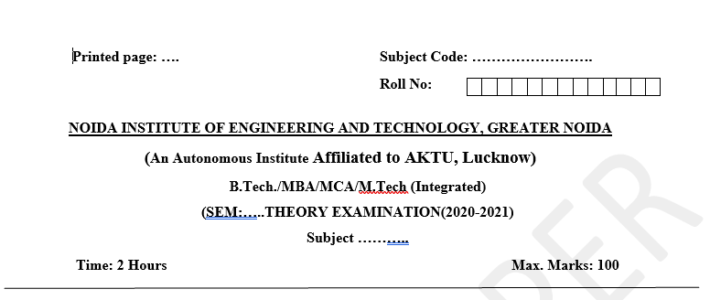
Pattern of Online External Exam Question Paper (100 marks)

Slide 20
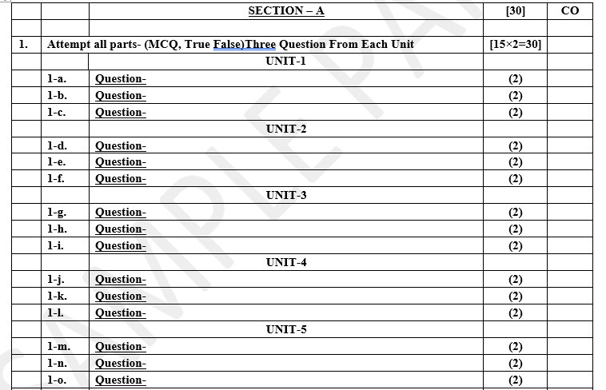
Pattern of Online External Exam Question Paper (100 marks)

Slide 21
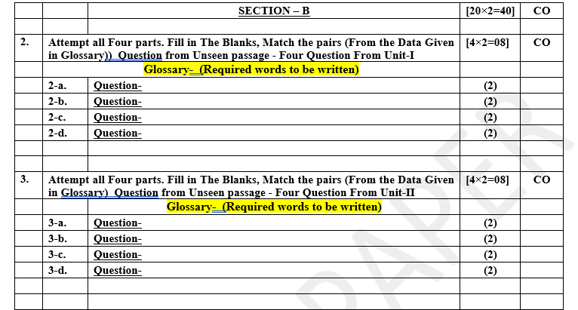
Pattern of Online External Exam Question Paper (100 marks)

Slide 22
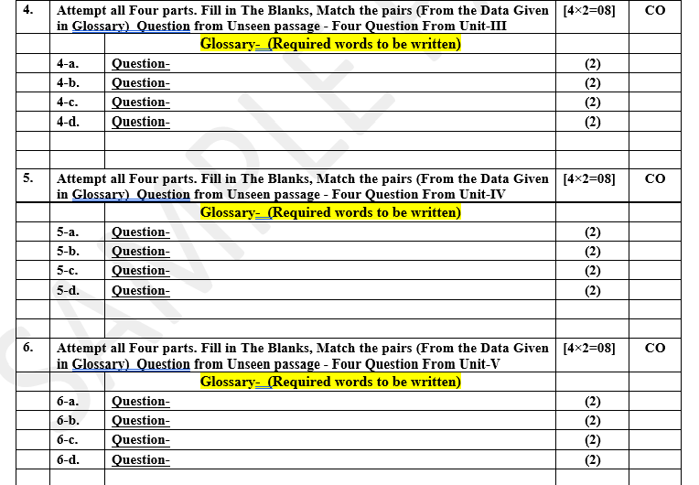
Pattern of Online External Exam Question Paper (100 marks)

Slide 23
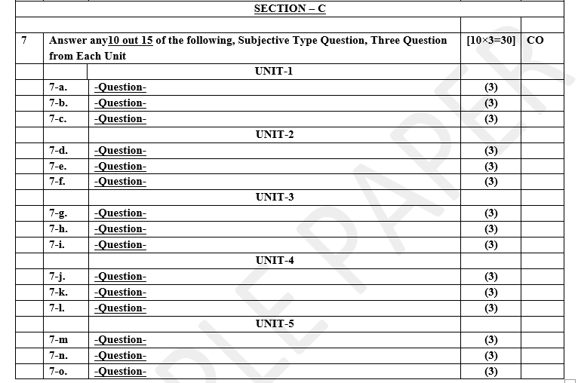
Pattern of Online External Exam Question Paper (100 marks)

Slide 24
Prerequisite / Recap
Student should have knowledge of HTML , CSS and JavaScript .
Students should have good knowledge of Python Programming and Python coding experience.
knowledge of Computer and basic skill.
Good problem solving Skill .

Slide 25
Brief Introduction about the Subject with videos
YouTube /other Video Links
https://youtu.be/eoPsX7MKfe8?list=PLIdgECt554OVFKXRpo_kuI0XpUQKk0ycO
https://youtu.be/tA42nHmmEKw?list=PLh2mXjKcTPSACrQxPM2_1Ojus5HX88ht7
https://youtu.be/8ndsDXohLMQ?list=PLDsnL5pk7-N_9oy2RN4A65Z-PEnvtc7rf
https://youtu.be/QXeEoD0pB3E?list=PLsyeobzWxl7poL9JTVyndKe62ieoN-MZ3
https://youtu.be/9MmC_uGjBsM?list=PL3pGy4HtqwD02GVgM96-V0sq4_DSinqvf

Slide 26
Unit III Content
Introduction to Django Authentication System.
Security Problem & Solution with Django
Creating Registration Form using Django.
Adding Email Field In Forms, Configuring email settings, Sending emails with Django.
Adding Grid Layout On Registration Page.
Adding Page Restrictions, Login Functionality Test and Logout.

Slide 27
Unit III Objective
In Unit III, the students will be able to find
Introduction to Django Authentication System.
The idea of a python Library .
Adding Email Field In Forms, Configuring email settings, Sending emails with Django
Adding Page Restrictions, Login Functionality Test and Logout.

Slide 28
Topic Objective
Topic : Introduction to Django Authentication System.
In this topic, the students will gain to giving users the ability to create an account they can sign into is a common function for many websites.

Slide 29
Django authentication system
The Django authentication system handles both authentication and authorization. Briefly, authentication verifies a user is who they claim to be, and authorization determines what an authenticated user is allowed to do.
The auth system consists of:
Users
Permissions: Binary (yes/no) flags designating whether a user may perform a certain task.
Groups: A generic way of applying labels and permissions to more than one user.
A configurable password hashing system
Forms and view tools for logging in users, or restricting content
A pluggable backend system

Slide 30
Introduction to Django Authentication System
For most websites, the basic entity of authentication is a user. A user is identified by some unique string, which is almost always an email address or username.
To prove someone is who they say they are, they must provide a password when creating an account, and again at any time they want to authenticate themselves. This should be familiar: you go through this kind of workflow any time you sign up for a service like Twitter or Netflix.
Django provides a User model for creating and managing users. Django users have a username and password, but can also optionally have an email address and a first and last name:

Slide 31
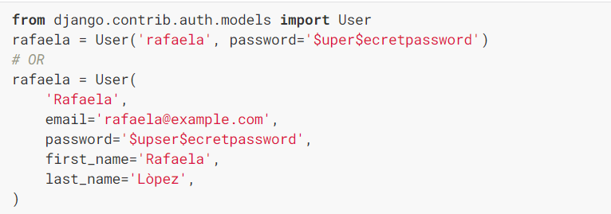
Introduction to Django Authentication System

Slide 32
Authentication support is bundled as a Django contrib module in django.contrib.auth. By default, the required configuration is already included in the settings.py generated by django-admin startproject, these consist of two items listed in your INSTALLED_APPS setting:
'django.contrib.auth' contains the core of the authentication framework, and its default models.
'django.contrib.contenttypes' is the Django content type system, which allows permissions to be associated with models you create.
and these items in your MIDDLEWARE setting:
SessionMiddleware manages sessions across requests.
AuthenticationMiddleware associates users with requests using sessions.
With these settings in place, running the command manage.py migrate creates the necessary database tables for auth related models and permissions for any models defined in your installed apps.

Slide 33
Introduction to Django Authentication System
Django provides a level of security when it comes to passwords. It has a built-in set of password validators, some of which are enabled by default in new projects. You can write your own validators to enforce any password rules you might need, but choose wisely.
In addition to password validation, Django safely stores password information by default. Django salts and hashes passwords before storing them when a user is created, so their plaintext password is no longer available outside the context of the initial registration request or when they log in.

Slide 34
Introduction to Django Authentication System
Django can authenticate a user by checking a supplied set of credentials against the existing set of registered users. If a user matches, Django will return that user object. Otherwise, it will return None.
From django.contrib.auth import authenticate
user = authenticate(
username='rafaela',
password='$uper$ecretpassword'
)
Django has a vast feature set for authenticating users and interacting with user objects to get things done.

Slide 35
Security Problem & Solution with Django
Django is widely lauded for its ease-of-use and pragmatic design, but like all software it is susceptible to its own share of critical vulnerabilities. Django's open source popularity means that default attack vectors are also widely known.
The application layer is increasingly targeted by hackers for penetration, and running full stack Python is no more/less vulnerable than any of the other application stacks. In fact, BitBucket , dpaste, and Mozilla Support are all employing Python/Django for their mission-critical web offerings, so have no fear—effective vulnerability management and visibility into existing Django security gaps can go a long way towards hardening your Django-based web app against attacks.

Slide 36
Security Problem & Solution with Django
Django’s Top 10 Vulnerabilities
10. Session Modification (CVE-2011-4136)‍
Versions 1.2.7 and 1.3.x before 1.3.1
When session details are stored in the cache, root namespacing is used for both session identifiers and application-data keys. This can allow remote attackers to modify a session by triggering use of a key that is equal to that session's identifier.

Slide 37
Security Problem & Solution with Django
Django’s Top 10 Vulnerabilities
9. Session Hijacking (CVE-2014-0482)
‍Versions 1.4.14, 1.5.x before 1.5.9, 1.6.x before 1.6.6, and 1.7 .
Session hijacking involves an attacker gaining unauthorized access to a system using another user’s session data.
In this case, when using contrib.auth.backends.RemoteUserBackend, remote authenticated users can hijack web sessions via vectors related to the REMOTE_USER header.

Slide 38
Security Problem & Solution with Django
Django’s Top 10 Vulnerabilities
Cache Poisoning (CVE-2014-1418)‍
Versions 1.4 before 1.4.13, 1.5 before 1.5.8, 1.6 before 1.6.5
Cache poisoning occurs when incorrect data is inserted into a DNS resolver ‘s cache, causing the nameserver to provide an incorrect IP address or destination. These versions of Django do not not properly include the:
Vary: Cookie
Cache-Control header in response
This can allow remote attackers to obtain sensitive information or poison the cache via a request from certain browsers.

Slide 39
Security Problem & Solution with Django
Django’s Top 10 Vulnerabilities
7. Arbitrary URLs Generation (CVE-2012-4520)
‍Versions 1.3.x before 1.3.4 and 1.4.x before 1.4.2
In these versions, the django.http.HttpRequest.get_host function allows remote attackers to generate and display arbitrary URLs via crafted username and password Host header values.

Slide 40
Security Problem & Solution with Django
Django’s Top 10 Vulnerabilities
CSRF: Unauthenticated Forged Requests (CVE-2011-4140)
‍Versions through 1.2.7 and 1.3.x through 1.3.1
CSRF is short for Cross Site Request Forgery, an attack that utilizes the user’s web browser to perform an unwanted action on another website in which the user is currently signed in. The CSRF protection mechanism in these versions of Django do not properly handle web-server configurations supporting arbitrary HTTP Host headers, allowing remote attackers to trigger unauthenticated forged requests via vectors involving a DNS CNAME record and a web page containing JavaScript code.

Slide 41
Security Problem & Solution with Django
Django’s Top 10 Vulnerabilities
5. CSRF Via Forged AJAX Requests (CVE-2011-0696)
‍Versions 1.1.x before 1.1.4 and 1.2.x before 1.2.5
These versions of Django do not properly validate HTTP requests that contain an X-Requested-With header, making it trivial for remote attackers to carry out cross-site request forgery (CSRF) attacks via forged AJAX requests that leverage a "combination of browser plugins and redirects," a related issue to CVE-2011-0447.

Slide 42
Security Problem & Solution with Django
Django’s Top 10 Vulnerabilities
4. Directory Traversal (CVE-2011-0698)
‍Versions 1.1.x before 1.1.4 and 1.2.x before 1.2.5 on Windows
In these versions of Django, remote attackers are able to read or execute files via a / (slash) character in a key in a session cookie, related to session replays.
3. DoS: Via Unspecified Vectors (CVE-2015-5145)
‍Versions 1.8.x before 1.8.3
DoS is short for Denial of Service, and occurs when an attacker brings down a network/website by flooding it with data packets. The validators.URLValidator in these versions of Django allow remote attackers to cause a denial of service (CPU consumption) via unspecified vectors.

Slide 43
Security Problem & Solution with Django
Django’s Top 10 Vulnerabilities
DoS : Via Multiple Requests With Unique Session Keys (CVE-2015-5143)
‍Versions before 1.4.21, 1.5.x through 1.6.x, 1.7.x before 1.7.9, and 1.8.x before 1.8.3
The session backends in Django allows remote attackers to cause a denial of service (session store consumption) via multiple requests with unique session keys.

Slide 44
Security Problem & Solution with Django
Django’s Top 10 Vulnerabilities
1. Type Conversion Vulnerability (CVE-2014-0474)
‍Versions before 1.4.11, 1.5.x before 1.5.6, 1.6.x before 1.6.3, and 1.7.x before 1.7 beta
In these versions of Django, the following field classes do not properly perform type conversion :
FilePathField
GenericIPAddressField
IPAddressField
This gives remote attackers access to unspecified impact and vectors related to MySQL.

Slide 45
Security Problem & Solution with Django
Remediation of Django
To fix the above vulnerabilities, you'll need to update the current working version of your Django framework in all your environments. And while Django is backwards compatible, it is nonetheless crucial that you identify any components in your web app that might be impacted by patching/updating.
UpGuard provides a way for you to do this easily and automatically with a few mouse clicks. Our powerful policy engine can validate secure configurations for all environments, infrastructures, and application stacks. In this case, a simple Django security policy can be run to check for any of the above vulnerabilities—as well as new vulnerabilities not yet added to policy. Our OVAL-backed vulnerability detection and monitoring suite ensures that all your Django components are free for vulnerabilities and security gaps.

Slide 46
Creating Registration Form using Django
Create Sign Up Form
First of all, create a URL for your signup page by adding a new path to the urlpatterns list in urls.py.
from . import views
from django.conf.urls import url, include
from django.urls import path
urlpatterns = [
url(r'^$', views.index, name='home'),
path('signup/', views.signup, name='signup'), # newly added

Slide 47
Creating Registration Form using Django
Create forms.py file if it is not present and add the following class for the sign-up form.
For creating sign up form, we can use the Django UserCreationForm.
django.contrib.auth.models import User
from django.contrib.auth.forms import UserCreationForm
class SignUpForm(UserCreationForm):
class Meta:
model = User
fields = ('username', 'password1', 'password2', )
Create a view to process the signup data and save that data into the database. You can simply use below function definition in your views.py file.

Slide 48
Creating Registration Form using Django
from .forms import SignUpForm
def signup(request):
if request.method == 'POST':
form = SignUpForm(request.POST)
if form.is_valid():
user = form.save()
user.refresh_from_db()
# load the profile instance created by the signal
user.save()
raw_password = form.cleaned_data.get('password1')
# login user after signing up
user = authenticate(username=user.username, password=raw_password)
login(request, user)
# redirect user to home page
return redirect('home')
else:
form = SignUpForm()
return render(request, 'signup.html', {'form': form})

Slide 49
Creating Registration Form using Django
Create a sign-up HTML page in your template directory.
{% extends 'base.html' %}
<h2>Sign up</h2>
<form method="post">
{% csrf_token %}
{% for field in form %}
<p>
{{ field.label_tag }}<br>
{{ field }}
{% if field.help_text %}
<small style="color: grey">{{ field.help_text }}</small>
{% endif %}
{% for error in field.errors %}
<p style="color: red">{{ error }}</p>
{% endfor %}
</p>
{% endfor %}
<button type="submit">Sign up</button>
</form>
{% endblock %}

Slide 50
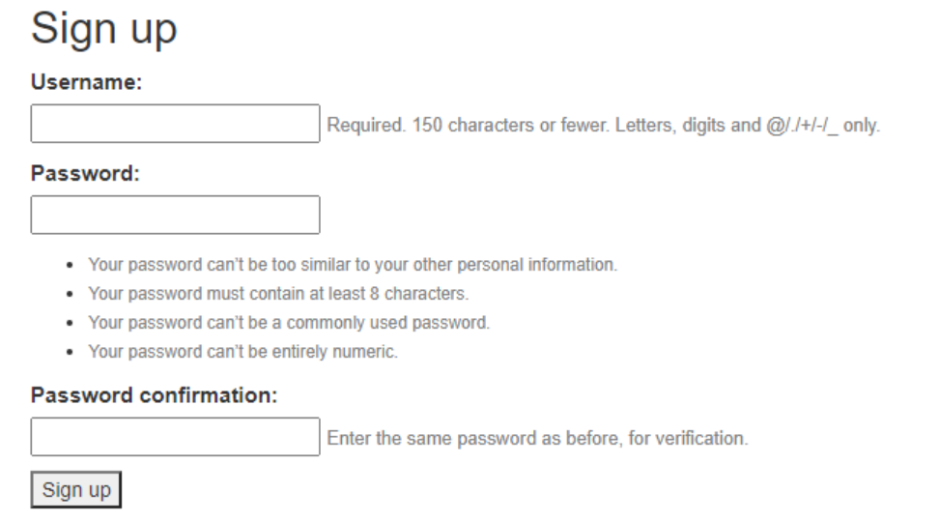
Creating Registration Form using Django
Run your Django project locally. Open the below URL in your browser.
http://127.0.0.1:8000/signup/
This is what the signup form will look like.

Slide 51
Adding Email ,Configuring email & Sending emails with Django
Django Mail Setup
Sending email using Django is pretty easy and require less configuration. In this lecture, we will send email to provided email.
For this purpose, we will use Google's SMTP and a Gmail account to set sender.
Django provides built-in mail library django.core.mail to send email.
Before sending email, we need to make some changes in Gmail account because for security reasons Google does not allow direct access (login) by any application. So, login to the Gmail account and follow the urls. It will redirect to the Gmail account settings where we need to allow less secure apps but toggle the button. See the below screenshot.

Slide 52
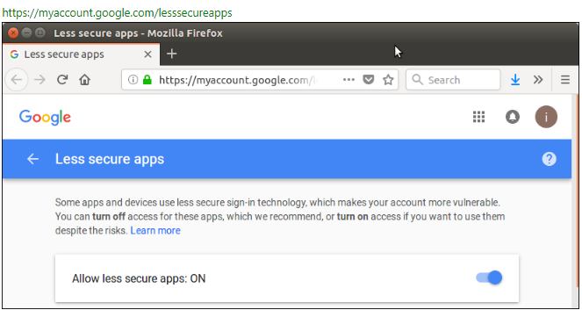
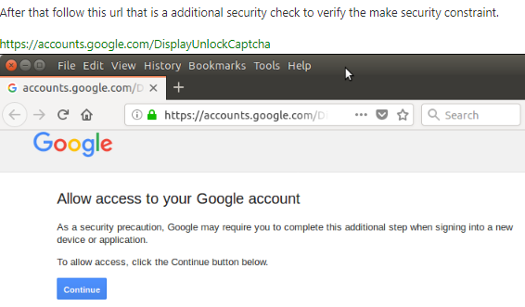
Adding Email ,Configuring email & Sending emails with Django

Slide 53
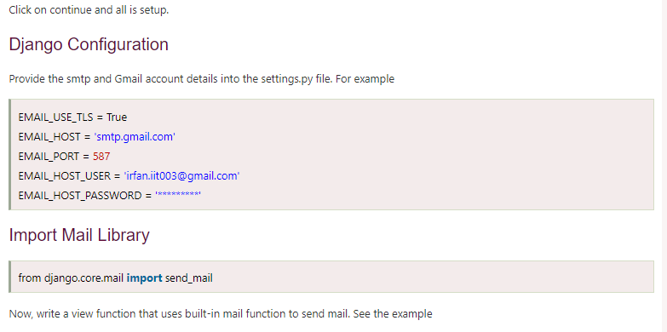
Adding Email ,Configuring email & Sending emails with Django

Slide 54
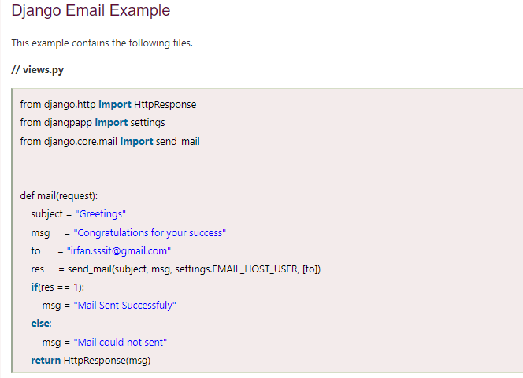
Adding Email ,Configuring email & Sending emails with Django

Slide 55
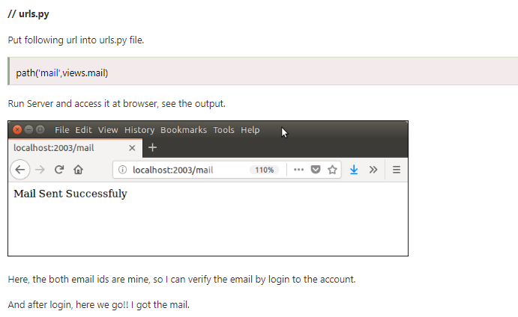
Adding Email ,Configuring email & Sending emails with Django

Slide 56
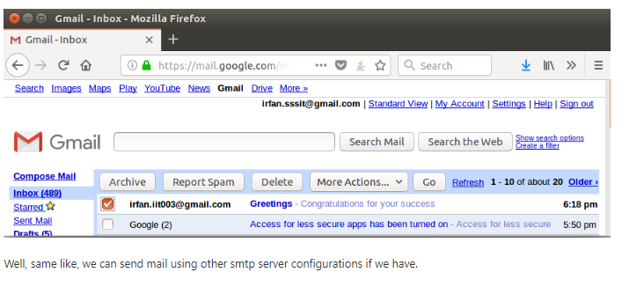
Adding Email ,Configuring email & Sending emails with Django

Slide 57
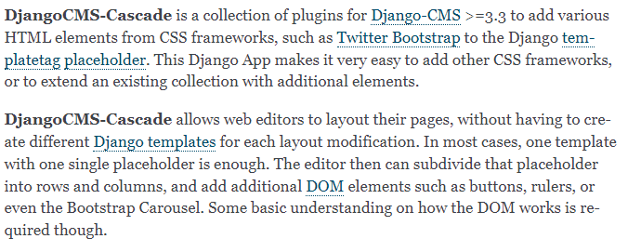
Adding Grid Layout On Registration Page

Slide 58
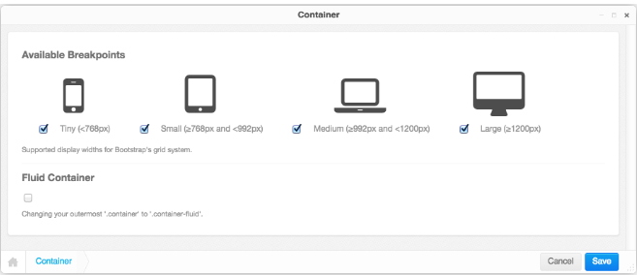
Adding Grid Layout On Registration Page
Bootstrap Container
A Container is the outermost component the Bootstrap framework knows of. Here the designer can specify the breakpoints of a web page. By default, Bootstrap offers 4 breakpoints: “large”, “medium”, “small” and “tiny”. These determine for which kind of screen widths, the grid system may switch the layout.
The editor window for a Container element offers the possibility to deactivate certain breakpoints. While this might make sense under certain conditions, it is safe to always keep all four breakpoints active, since this gives the designer of the web page the maximum flexibility.

Slide 59
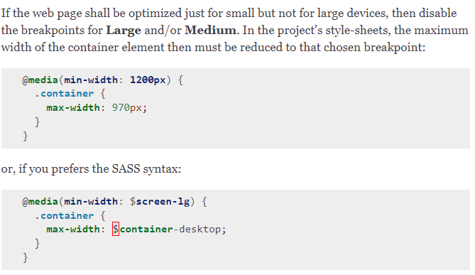
Adding Grid Layout On Registration Page
Small devices exclusively :-

Slide 60
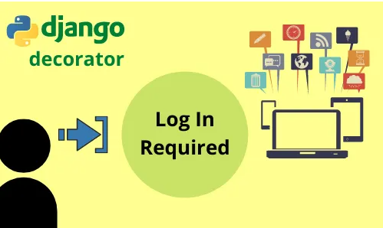
Adding Page Restrictions
Creating a website is fun, but a login restrictor in your website will make it look more secure. Django REST Framework is a robust and flexible toolkit for building Web APIs. The Django login required decorator provide the feature to restrict the access
We have often visited websites in which we need to log in first before accessing or visiting other pages. In other words, restricting access.

Slide 61
Adding Page Restrictions
We also came across some of our projects where we need to do the same but wonder how? So yes you came to the right place, but before moving ahead let’s first sneak peek about the login decorator in Django Rest Framework. login_required() decorator does the following things:-
Execute normally the view if the user is logged in.
Redirect the user to the login_url path if the user is not logged in.
Syntax:-
@login_required(login_url=”html page”)
In this lecture , we will understand how to restrict access with the Django login required decorator function? Where to use it? And all about it.

Slide 62
Why Decorators?
Django provides several decorators that can be applied to views to support various HTTP features.
Decorators are an easy way to clean up your code and separate the view authentication process from the view functionality. Django has several useful built-in decorators such as @login_required, @permission_required for user permissions and @require_http_methods for restricting request methods (GET|POST).

Slide 63
Login Functionality Test and Logout
Exaplaining Django Login and Logout. Django is a High-Level Web Framework and it has lots of built-in features. We can use those built-in functions for our common use of Web Application. Some of the functions are Permission and User Control, Signals, Templates, Django ORM, Access Control List, etc. Out of this Registration App, is a good example and a good thing about it is that the features can be used out-of-the-box.
With the Authentication Views, you can take advantage of the following features
Login
logout
User Registration
Change Password
Reset Password or Forgot Password

Slide 64
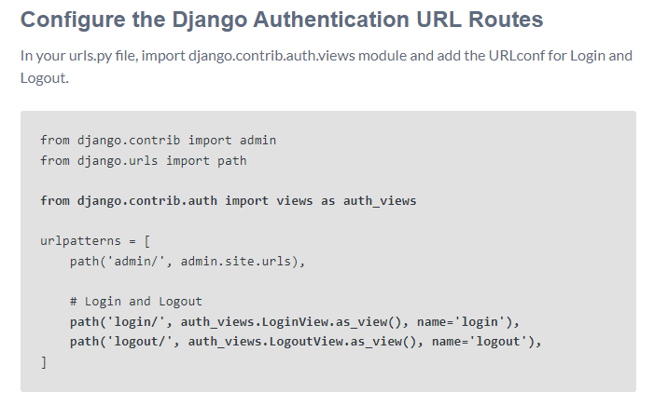
Login Functionality Test and Logout

Slide 65
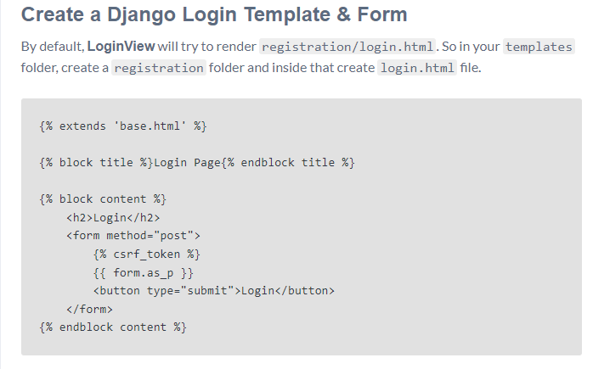
Login Functionality Test and Logout

Slide 66
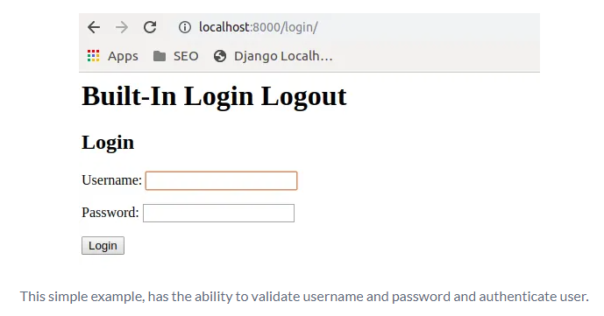
Login Functionality Test and Logout

Slide 67
Daily Quiz
Discuss Django Authentication System.
What is the role of frameworks in python.
Discuss any three frameworks.
Discuss about , Security Problem & Solution with Django .
Discuss implementation rule of Falcon.
Discuss the Zappa framework.
Discuss the role of Dash.
Discuss the application area of cherryPy.
Discuss about the Request Http methods in Python.
Discuss about Flask application.

Slide 68
Weekly Assignment
What are the most important uses of Django.
What are the disadvantages of Django?
What are the different data types used in Django.
What are the salient features of Django.
What are some of the technical features that Django includes

Slide 69
Topic Link ( YouTube & NPTEL Video Links)
YouTube /other Video Links
https://youtu.be/eoPsX7MKfe8?list=PLIdgECt554OVFKXRpo_kuI0XpUQKk0ycO
https://youtu.be/tA42nHmmEKw?list=PLh2mXjKcTPSACrQxPM2_1Ojus5HX88ht7
https://youtu.be/8ndsDXohLMQ?list=PLDsnL5pk7-N_9oy2RN4A65Z-PEnvtc7rf
https://youtu.be/QXeEoD0pB3E?list=PLsyeobzWxl7poL9JTVyndKe62ieoN-MZ3
https://youtu.be/9MmC_uGjBsM?list=PL3pGy4HtqwD02GVgM96-V0sq4_DSinqvf

Slide 70
MCQ s
1. What is a Django App? ADjango app is an extended package with base package is Django B. Django app is a python package with its own components. C. Both 1 & 2 Option D. All of the above | 2. Django was introduced by A. Adrian Holovaty B. Bill Gates C. Rasmus Lerdorf D. Tim Berners-Lee
3. What are Migrations in Django A. They are files saved in migrations directory. B. They are created when you run make migrations command. C. Migrations are files where Django stores changes to your models. D. All of the above
4. Which architectural pattern does django follow APHP B. MVT C. HTML D. None of the above

Slide 71
MCQ s
which of these is not a valid backend for caching in django
A. Django.core.cache.backends.sys.memory
B. django.core.cache.backends.db.DatabaseCache
C. django.core.cache.backends.locmem.LocMemCache
D. None of the above
5. Which architectural pattern does django follow
A.PHP
B. MVT
C. HTML
D. None of the above

Slide 72
MCQ s
6. Python is a : Development environment Set of editing tools Programming Language | Python is Case Sensitive when dealing with Identifiers? Yes No Sometimes Only None Of the Above
What is the OUTPUT of the following Statement? print 0xA + 0xB + 0xC : 0xA0xB0xC 33 ABC 000XXXABC | What is the OUTPUT when the following Statement is executed? “abc”+”xyz” abc abcxyz abcz abcxy
what is the type of a? a={1,2:3} list set dict syntax error

Slide 73
Glossary Questions
Top 10 design pattern interview questions
Explain Django Architecture?
Explain the Django project directory structure?
What are models in Django?
What are templates in Django or Django template language?
What are views in Django?
What is Django ORM?
What is Django Rest Framework(DRF)?
What is the difference between a project and an app in Django?
What are different model inheritance styles in the Django?
What are Django Signals?

Slide 74
Expected Questions for University Exam
Top 10 design pattern interview questions
Explain Django Architecture?
Explain the Django project directory structure?
What are models in Django?
What are templates in Django or Django template language?
What are views in Django?
What is Django ORM?
What is Django Rest Framework(DRF)?
What is the difference between a project and an app in Django?
What are different model inheritance styles in the Django?
What are Django Signals?

Slide 75
Summary
Till Now we understand The idea of this module Introduction to Django Authentication System To prove someone is who they say they are, they must provide a password when creating an account, and again at any time they want to authenticate themselves. This should be familiar: you go through this kind of workflow any time you sign up for a service like Twitter or Netflix. Django is widely lauded for its ease-of-use and pragmatic design, but like all software it is susceptible to its own share of critical vulnerabilities. Django's open source popularity means that default attack vectors are also widely known.

Slide 76
References
(1) Tom Aratyn, “Building Django 2.0 Web Applications: Create enterprise-grade, scalable Python web applications easily with Django 2.0”, 2nd Edition 2018, Packt Publishing.
(2) Nigel George, “Build a website with Django”, 1st Edition 2019, GNW Independent Publishing Edition.
(3) Ray Yao,” Django in 8 Hours: For Beginners, Learn Coding Fast!, 2nd Edition 2020, Independently published Edition.
(4) Harry Percival, “Test-Driven Development with Python: Obey the Testing Goat: Using Django, Selenium, and JavaScript”, 2nd Edition 2019, Kindle Edition.

Slide 77
THANK YOU

